Slide 1
NLP and Some Text mining Methods: Introduction

Slide 2
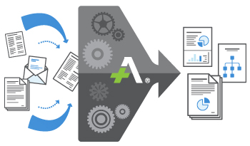
NLP & it’s History
Natural Language Processing:
Natural Language Processing is a sub field of Artificial Intelligence used to aid computers to programmatically understand the human's natural language to process and analyse large amounts of natural language data and develop insights out of that.
Data is question can be any unstructured data . E.g. Voice , Chat, social media data, feedback on any product, news etc.
History:
Way back in seventeenth century, philosophers such as Leibniz and Descartes placed the proposal of codes to relate different languages, but those thought remained theoretical
In 1930s Georges Artsrouni, using paper tape, created the first bilingual dictionary
The other proposal, by Peter Troyanskii, a Russian, was more detailed. It included both the bilingual dictionary, and rationale of grammatical roles between languages
In 1950 , Alan Turing published his famous article "Computing Machinery and Intelligence" had a mention of thinking capability of machine
In 1980 first Statistical machine translation systems were developed: Based on statistical model

Slide 3
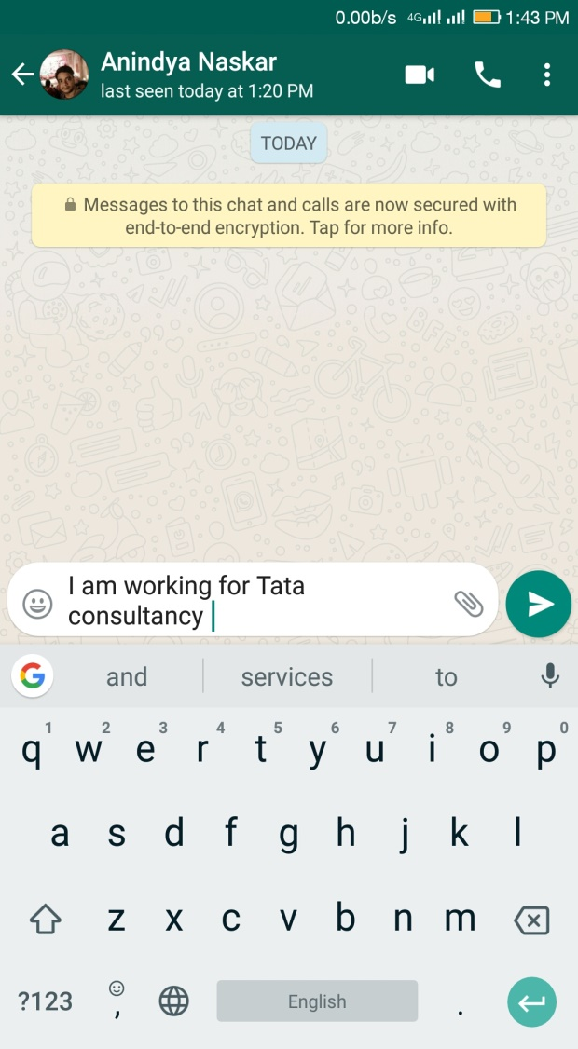
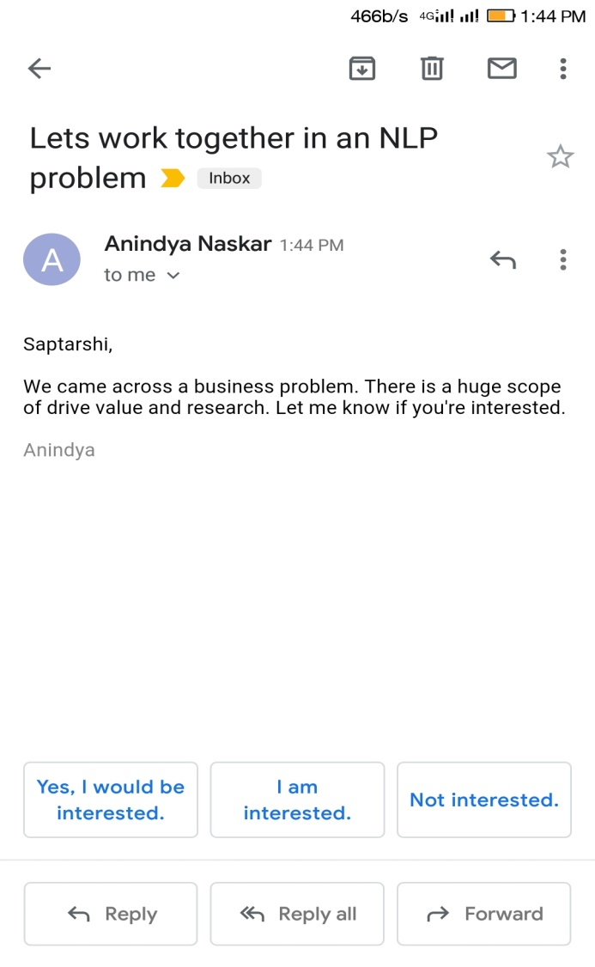
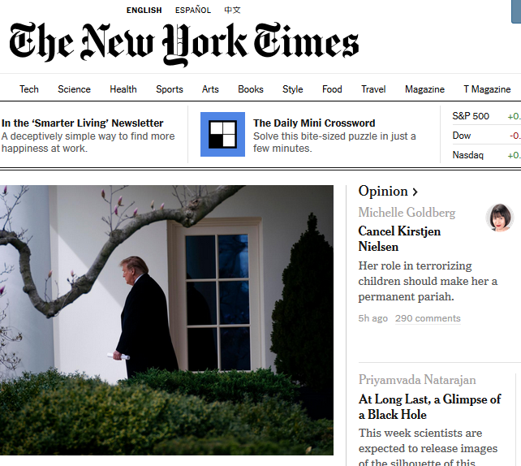

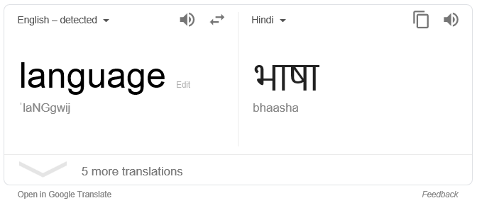
Application of NLP
Gmail Auto Reply
Keyboard Next Word Prediction
Google Translator
IMDB Movie Review
NY Article Recommendation

Slide 4
More Applications
Spam email detection
Trend analysis
Call center chat text transcript analysis:
Customer Sentiment & satisfaction
Performance of the caller
Overall rooted business problem(s) identification
Movie review

Slide 5
Preprocessing (1)
Data cleaning
Goal: get clean ASCII text
Remove HTML markup*, pictures, advertisements, ...
Automate this: wrapper induction
* Note: HTML markup may carry information too (e.g., <b> or <h1> marks something important), which can be extracted! (Depends on the application)

Slide 6
Preprocessing (2)
Lemmatize / stem
ex. buyers, buyer → buyer / buyer, buying, ... → buy
Remove stopwords
Find Named Entities (people, places, companies, ...); filtering
Resolve homonymy: “synonym unification“
Part-of-speech tagging; filtering of nouns, verbs, adjectives, ...
Stop word removal: Article, prepositon etc.
Most steps are optional and application-dependent!
Many steps are language-dependent; coverage of non-English varies
Free and/or open-source tools or Web APIs exist for most steps

Slide 7

Mining Text Data: An Introduction
Data Mining / Knowledge Discovery
Structured Data Multimedia Free Text Hypertext
HomeLoan (
Loanee: Frank Rizzo
Lender: MWF
Agency: Lake View
Amount: $200,000
Term: 15 years
)
Frank Rizzo bought
his home from Lake
View Real Estate in
1992.
He paid $200,000
under a15-year loan
from MW Financial.
<a href>Frank Rizzo
</a> Bought
<a hef>this home</a>
from <a href>Lake
View Real Estate</a>
In <b>1992</b>.
<p>...
Loans($200K,[map],...)
Notes:
Throughout this course we have been discussing Data Mining over a variety of data types.
Two former types we covered were Structured Data (relational) and multimedia data.
Today and in the last class we have been discussing Data Mining over free text,
and our next section will cover hypertext, such as web pages.
Text mining is well motivated, due to the fact that much of the world’s data can be
found in free text form (newspaper articles, emails, literature, etc.). There is a
lot of information available to mine.
While mining free text has the same goals as data mining in general
(extracting useful knowledge/stats/trends), text mining must overcome
a major difficulty – there is no explicit structure.
Machines can reason will relational data well since schemas are explicitly available.
Free text, however, encodes all semantic information within natural language. Our
text mining algorithms, then, must make some sense out of this natural language
representation. Humans are great at doing this, but this has proved to be a problem for machines.

Slide 8
Bag-of-Tokens Approaches
Documents
Token Sets
Four score and seven years ago our fathers brought forth on this continent, a new nation, conceived in Liberty, and dedicated to the proposition that all men are created equal.
Now we are engaged in a great civil war, testing whether that nation, or …
nation – 5
civil - 1
war – 2
men – 2
died – 4
people – 5
Liberty – 1
God – 1
…
Feature
Extraction
Loses all order-specific information!
Severely limits context!
Notes:
The previous text mining presentations “made sense” out of free text by
viewing text as a bag-of-tokens (words, n-grams). This is the same approach as IR.
Under that model we can already summarize, classify, cluster, and compute co-occurrence stats over free text.
These are quite useful for mining and managing large volumes of free text.
However, there is a potential to do much more. The BOT approach loses a LOT of information
contained in text, such as word order, sentence structure, and context. These are precisely the
features that humans use to interpret text.
Thus the natural question is can we do better?

Slide 9
Term frequency
Term frequency is a measure of the importance of term i in document j
Inverse document frequency (which we see next) is a measure of the general importance of the term.
I.e. High term frequency for “apple” means that apple is an important word in a specific document.
But high document frequency (low inverse document frequency) for “apple”, given a particular set of documents, means that apple is not all that important overall, since it is in all of the documents.

Slide 10
Inverse document frequency
Inverse document frequency of term i is:
Log of: … the number of documents in the master collection,
divided by the number of those documents that contain the term.

Slide 11
TFIDF encoding of a document
So, given:
- a background collection of documents
(e.g. 100,000 random web pages,
all the articles we can find about cancer
100 student essays submitted as coursework
…)
- a specific ordered list (possibly large) of terms
We can encode any document as a vector of TFIDF numbers,
where the ith entry in the vector for document j is:

Slide 12
From Wikipedia‘s plot summary (method: string search)
...
Natasha is convinced that she loves Anatole and writes to Princess Maria, Andrei's sister, breaking off her engagement [with Andrei]. At the last moment, Sonya discovers her plans to elope and foils them. Pierre is initially horrified by Natasha's behavior, but realizes he has fallen in love with her. During the time when the Great Comet of 1811–2 streaks the sky, life appears to begin anew for Pierre.
Prince Andrei coldly accepts Natasha's breaking of the engagement. He tells Pierre that his pride will not allow him to renew his proposal. Ashamed, Natasha makes a suicide attempt and is left seriously ill.
...
Having lost all will to live, [Andrei] forgives Natasha in a last act before dying.
Pierre's wife Hélène dies from an overdose of abortion medication (Tolstoy does not state it explicitly but the euphemism he uses is unambiguous). Pierre is reunited with Natasha, while the victorious Russians rebuild Moscow. Natasha speaks of Prince Andrei's death and Pierre of Karataev's. Both are aware of a growing bond between them in their bereavement. With the help of Princess Maria, Pierre finds love at last and, revealing his love after being released by his former wife's death, marries Natasha.
Total time: 29 mins since creation of word cloud,
17 mins since creation of Pierre-Natasha-Andrew chart
(includes making these slides for you)
Notes:
https://en.wikipedia.org/wiki/War_and_Peace

Slide 13
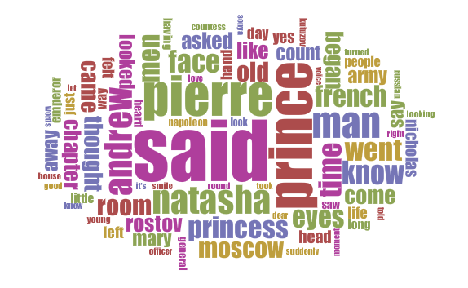
Speed-reading with word clouds: The Voyant tool (single-digit number of seconds)
Notes:
http://www.gutenberg.org/cache/epub/2600/pg2600.txt
„Russia“ appears 173 times

Slide 14
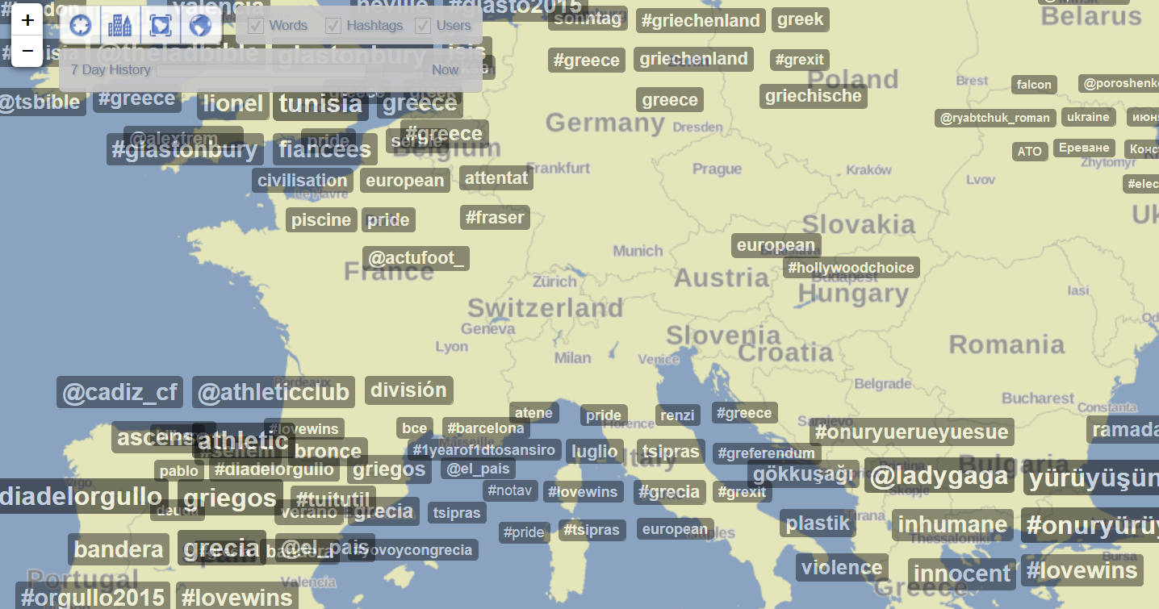
Trending topics: a form of summarization
Notes:
http://trendsmap.com/ mon 29th June

Slide 15
Word Cloud Generator
https://www.wordclouds.com/
Word cloud can be generated using your software of interest, e.g. R, Python etc.

Slide 16
Dependency Parsing
Automatic reads and finds out dependency
Helps to build generalized rule set after studying sample
Recommended package: sPacy, python

Slide 17
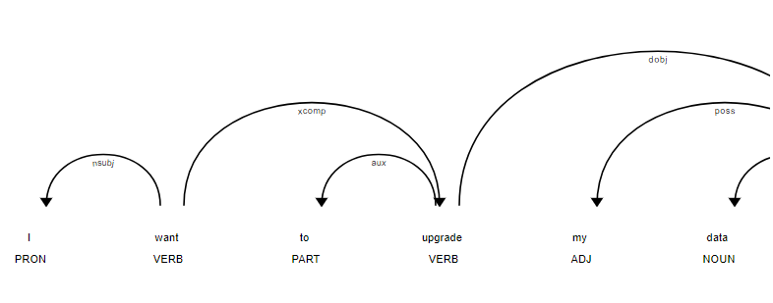
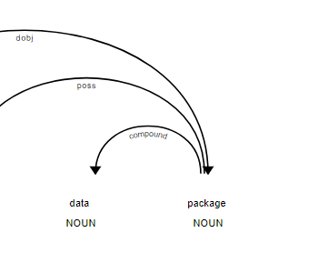
Dependency Parsing Examples ..1
I want to upgrade my data package

Slide 18
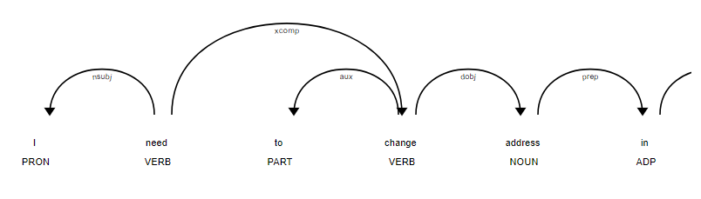
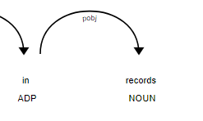
Dependency Parsing Examples ..2
I need to change address in records

Slide 19
Topic Modelling using LDA
https://algobeans.com/2015/06/21/laymans-explanation-of-topic-modeling-with-lda-2/

